Slide 1
Probability Distributions
BICT4702 Modelling & Simulation - MZUNI

Slide 2
Continuous Distributions

Slide 3
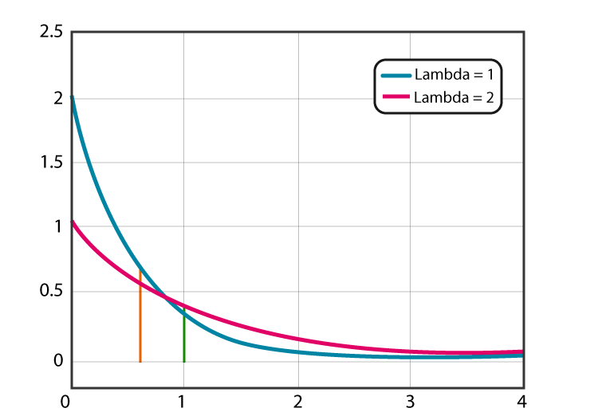
Exponential Distribution
Describes the time between events in a Poisson process (events happening randomly at a constant rate).
It has one parameter, λ (lambda), which controls the rate of events.
The probability of an event happening after a certain time decreases exponentially as time goes on.
Think of waiting times for customers at a store with a constant arrival rate.

Slide 4
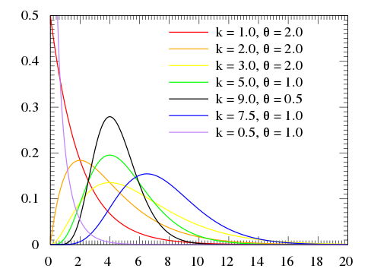
Gamma Distribution
This is more flexible than the exponential distribution and describes waiting times for multiple events in a Poisson process.
It has two parameters: α (alpha) and β (beta). Alpha controls the shape of the distribution, while beta controls the scale.
It's used in scenarios like modeling project durations or time to failure.

Slide 5
Discrete Distributions

Slide 6
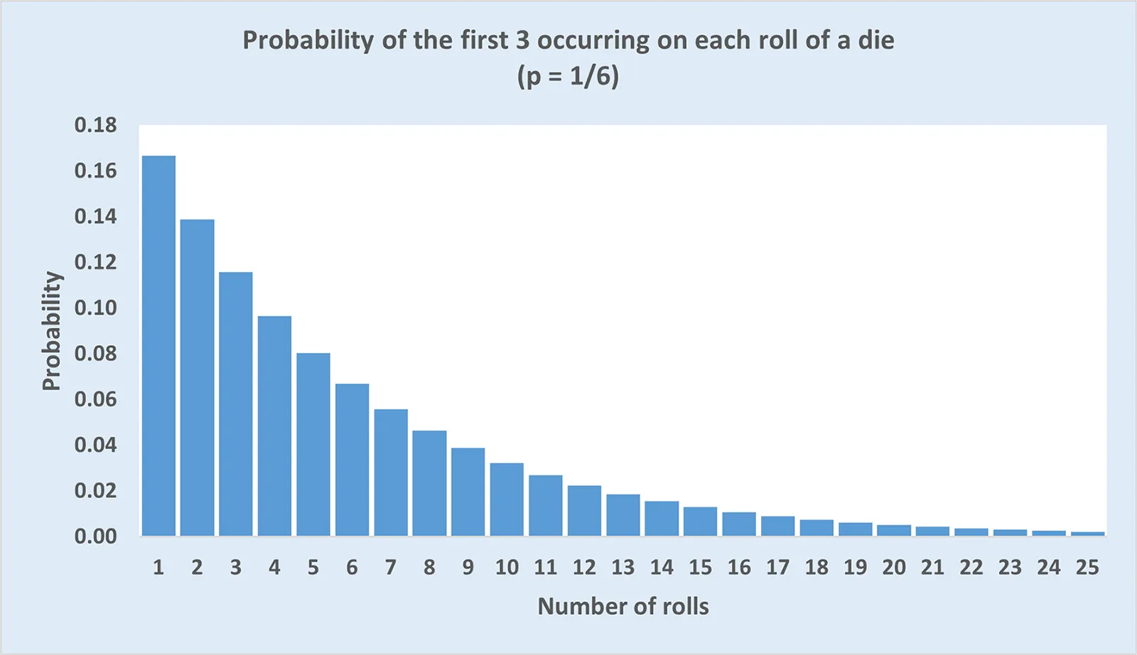
Geometric Distribution
This describes the number of trials needed for the first success in a sequence of independent Bernoulli trials (trials with only two outcomes, success and failure) with a constant probability of success, p.
The probability of needing more trials keeps decreasing as the number of trials increases.
Imagine flipping a coin until you get heads for the first time.

Slide 7
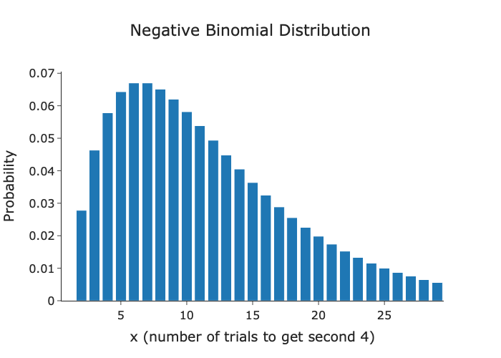
Negative Binomial Distribution
This is an extension of the geometric distribution.
It describes the number of trials needed to get a fixed number of successes (r) in a sequence of independent Bernoulli trials with a constant probability of success, p.
Useful for scenarios like counting the number of coin flips needed for 5 heads.

Slide 8
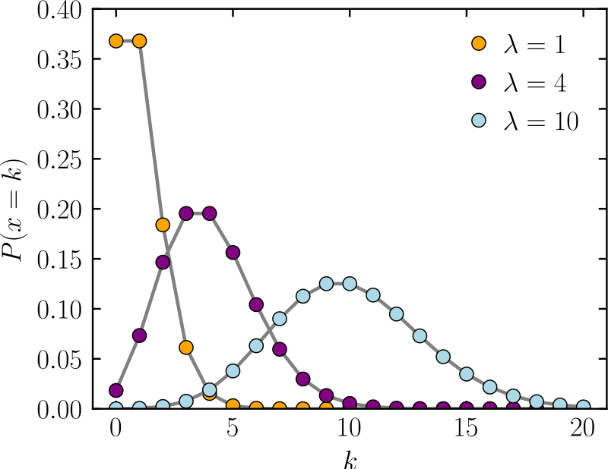
Poisson Distribution
Poisson Distribution: This describes the number of events occurring in a fixed interval of time or space, assuming the events happen independently and at a constant rate.
It has one parameter, λ (lambda), which is the average number of events expected in that interval.
Useful for modeling things like customer arrivals in a short time window

